Slide 1

EXCEL STATISTICS FOR BUSINESS ANALYTICS

Slide 2

George Mount
Data Analyst & Educator at Stringfest Analytics
George works as an independent analyst and data analytics educator with the goal to help clients manage their data so they think more creatively. He serves as a technical expert and lead curriculum developer for Thinkful’s data analytics program and is the instructor of the DataCamp course “Survey and Measure Development in R.”
George blogs about data, innovation, and career development at georgejmount.com. He holds a master’s degree in information systems with a certificate of achievement in quantitative methods from Case Western Reserve University

Slide 3

OBJECTIVES FOR TODAY
Explore a dataset for research questions
Check assumptions and build hypotheses
Test formally for a difference in means between two groups
Make compelling business recommendations using inferential statistics
Excel Statistics for Business Analytics

Slide 4

WHY WOULD WE DO THIS IN EXCEL?
“You get to look at the data every step of the way, building confidence while learning the tricks of the trade.”
-- John Foreman
Excel Statistics for Business Analytics

Slide 5
1. EXPLORATORY DATA ANALYSIS IN EXCEL

Slide 6


What the hey is EDA?
Preliminary understanding of variables
Classify them
Summarize them
Visualize them
Check assumptions before using them
YOU
YOUR DATA

Slide 7

What is a variable?
Classical statistics: at least a 90%/10% split

Slide 8

VARIABLE TYPES AS RECIPE INGREDIENTS

Slide 9
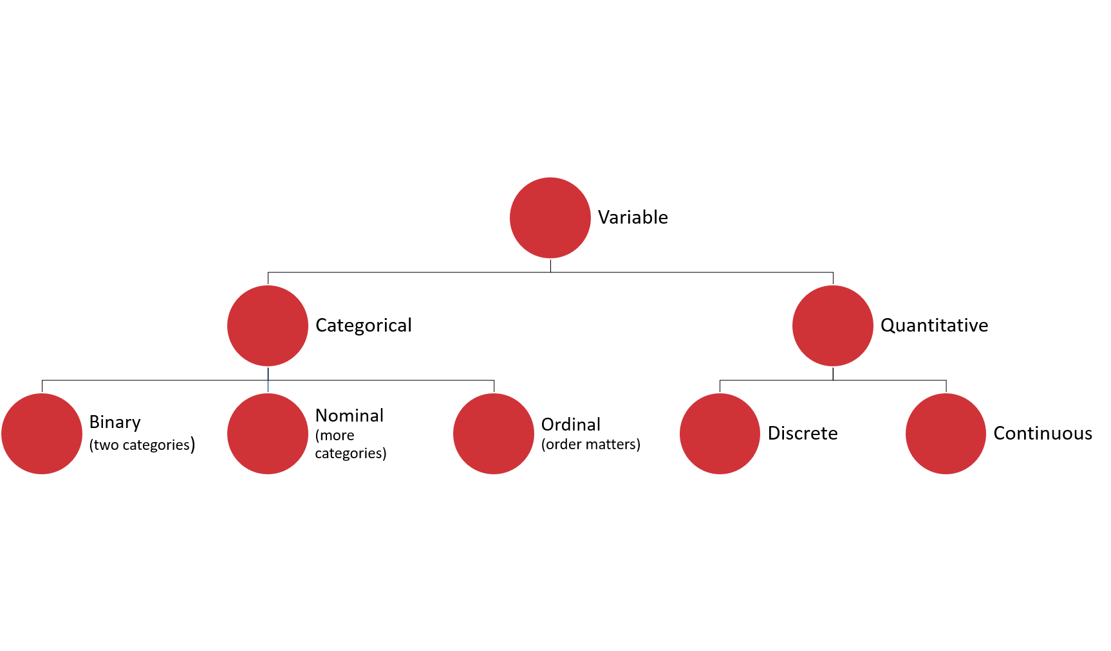

Slide 10
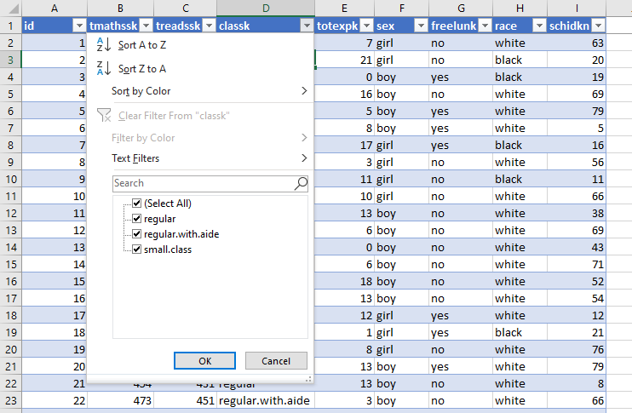
DRILL
File: wages.xlsx
What type is each variable?
(Don’t be afraid to poke at the data!)
Variable | Description | Type?
tmathssk | Total math scaled score
treadssk | Total reading scaled score
classk | Type of class
totexpk | Years of total teaching experience
sex | Sex
freelunk | Qualified for free lunch?
race | Race
schidkn | School indicator

Slide 11
DRILL
File: wages.xlsx
What type is each variable?
(Don’t be afraid to poke at the data!)
Variable | Description | Type?
tmathssk | Total math scaled score | Continuous
treadssk | Total reading scaled score | Continuous
classk | Type of class | Nominal
totexpk | Years of total teaching experience | Discrete
sex | Sex | Binary
freelunk | Qualified for free lunch? | Binary
race | Race | Nominal
schidkn | School indicator | Nominal

Slide 12

WHO KNOWS?
VARIABLE TYPES ARE CONTEXTUAL
IT’S NEBULOSE…

Slide 13
Summarizing a variable: frequencies
Used for categorical variables
How many of each value do we have? (Counts)
Use PivotTables
Demo: wages.xlsx
Notes:
Create a two-way cross-tab summarizing frequency counts of union/married.

Slide 14
Summarizing a variable: descriptive statistics
Descriptive statistics
Used for continuous variables
Central tendency: what value is the variable centered around?
Mean: “average”
Median: “middle”
Mode: “most common”

Slide 15
DRILL
You are consulting for a non-profit on fundraising strategies
Donation data is shown to the right
Which measure of central tendency (mean/median/mode) should be tracked?
Variable
10
10
20
30
100

Slide 16
DRILL
You are consulting for a non-profit on fundraising strategies
Donation data is shown to the right
Which measure of central tendency (mean/median/mode) should be tracked?
No one statistic rules them all
Variable
$10
$10
$20
$30
$100
Statistic | Value
Mean | $34
Median | $20
Mode | $10

Slide 17
Summarizing a variable: descriptive statistics
Variability: how spread is the variable from the center?
Range: What are the min/max?
Variance: Relative to the mean, how far away does the data fall?
Standard deviation: Square root of the variance

Slide 18
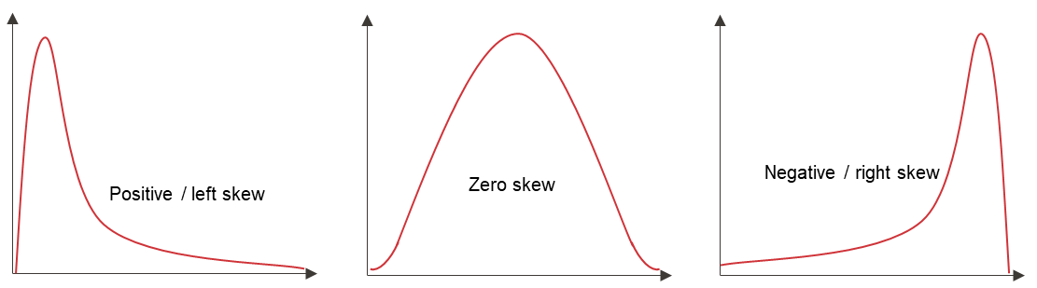
Summarizing a variable: descriptive statistics
Distribution: How is the data distributed?
Skewness: How lopsided is the data?

Slide 19
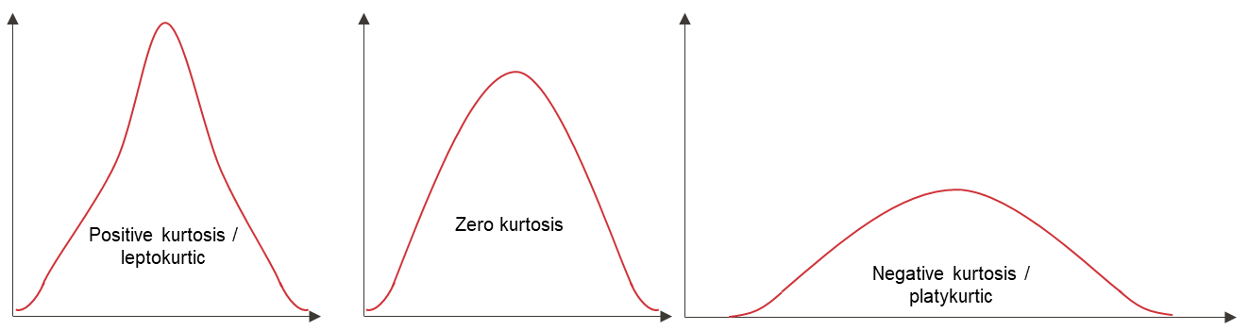
Summarizing a variable: descriptive statistics
Distribution: How is the data distributed?
Kurtosis: How jagged is the data?

Slide 20
HAVE YOU INSTALLED THE DATA ANALYSIS TOOLPAK?

Slide 21
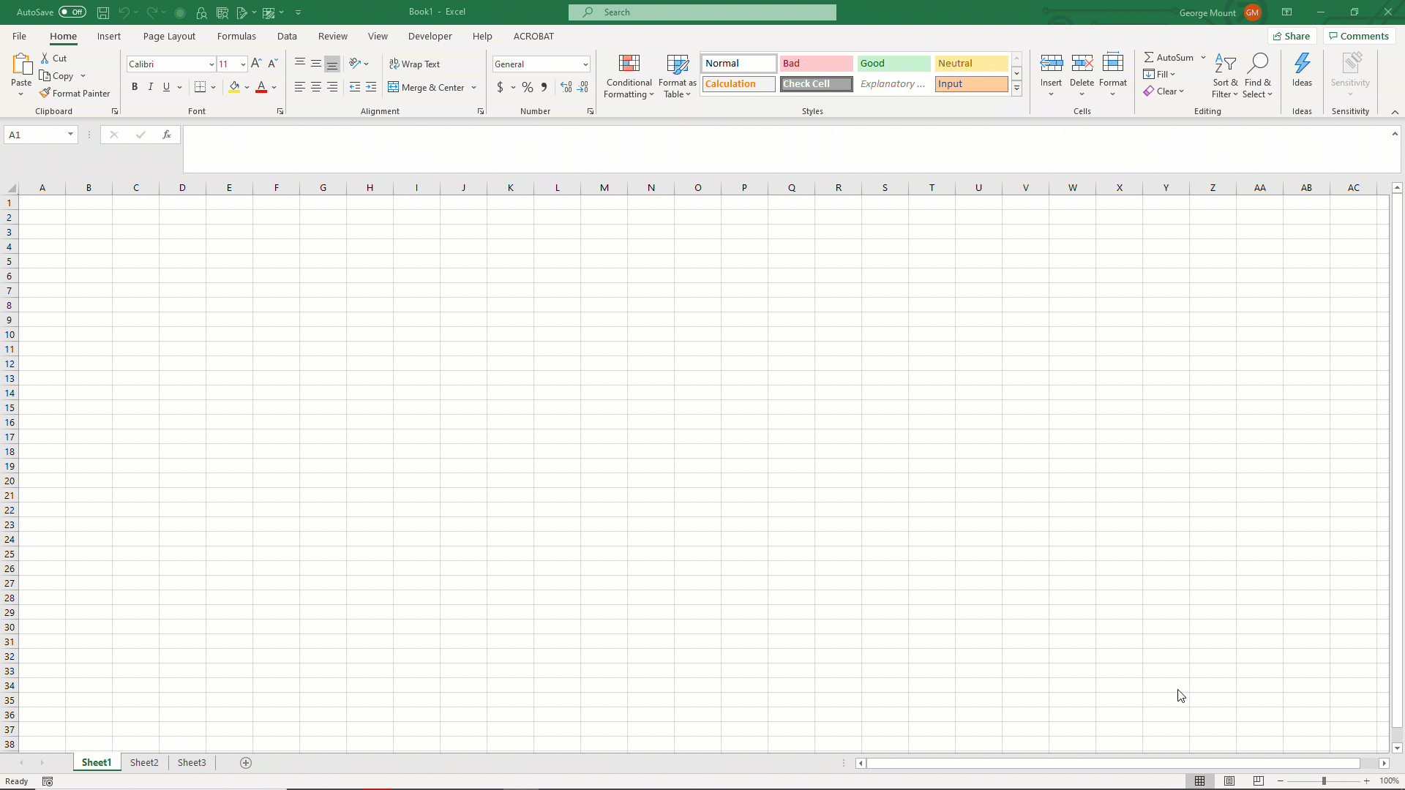
ON WINDOWS:

Slide 22
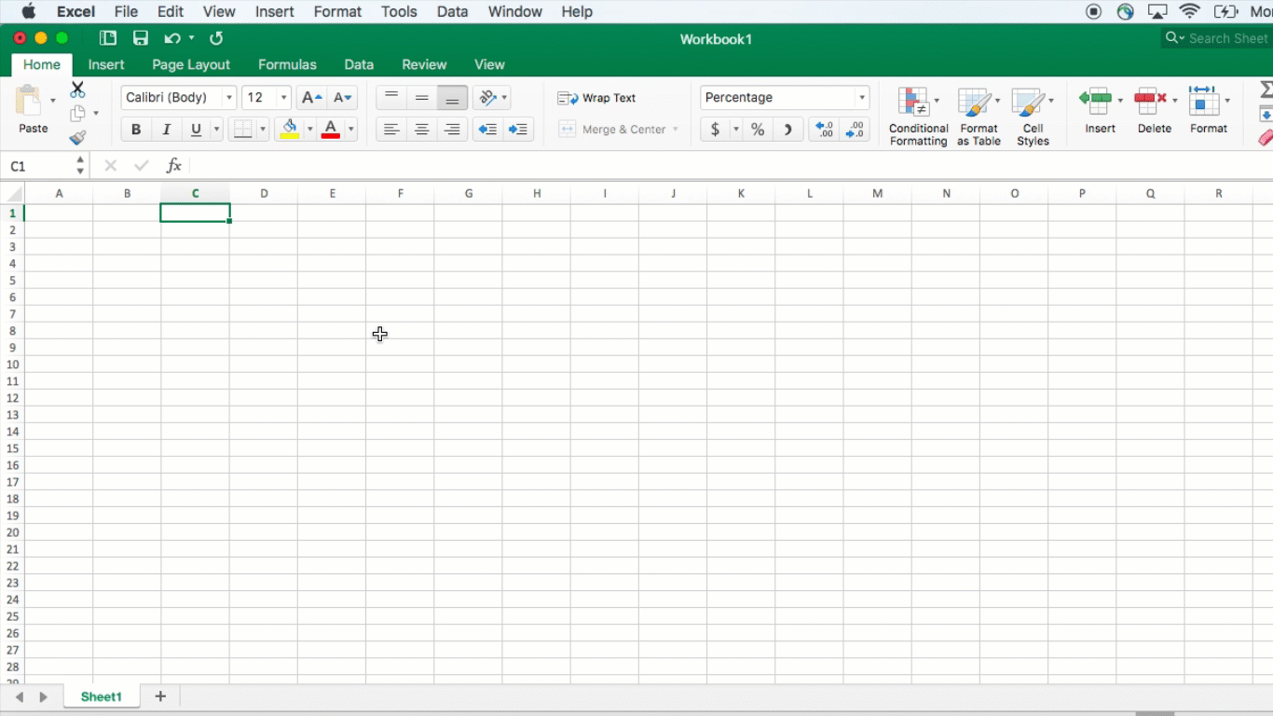
ON MAC:

Slide 23
DEMO
File: wages.xlsx
Summarize wage with the Analysis ToolPak

Slide 24
Summarizing a variable: visualization
Histogram
What does the data’s distribution “looks like?”
How many data points lie with each bin?

Slide 25
DEMO
File: wages.xlsx
Visualize wage with a histogram

Slide 26
DRILL
File: housing-descriptive.xlsx
Explore this dataset:
Choose a categorical variable and run its frequencies
Choose a continuous variable, run its frequencies and plot a histogram

Slide 27
QUESTIONS?

Slide 28
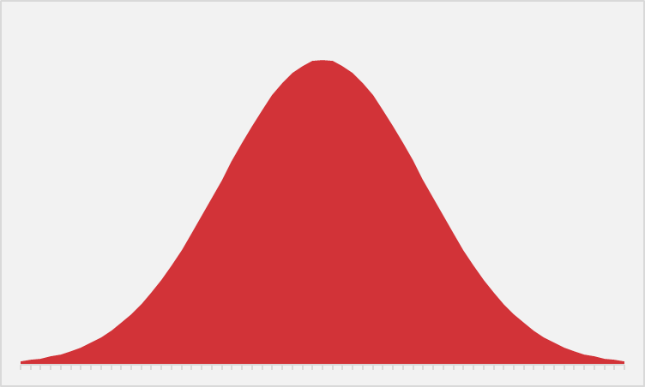
EVER WANTED TO JUST BE NORMAL?
STATISTICS IS YOUR CHANCE.

Slide 29

STATROULETTE
A roulette wheel returns values between 0 and 36.
Let’s simulate a game of roulette in Excel
Notes:
Instructions follow on the next slide.

Slide 30
DEMO
Simulate 500 rounds of a roulette toss using RANDBETWEEN(0,36)
Plot the resulting frequency distribution
Hit F9 while in your workbook. What happens?

Slide 31
DEMO
File: stat-roulette.xlsx

Slide 32
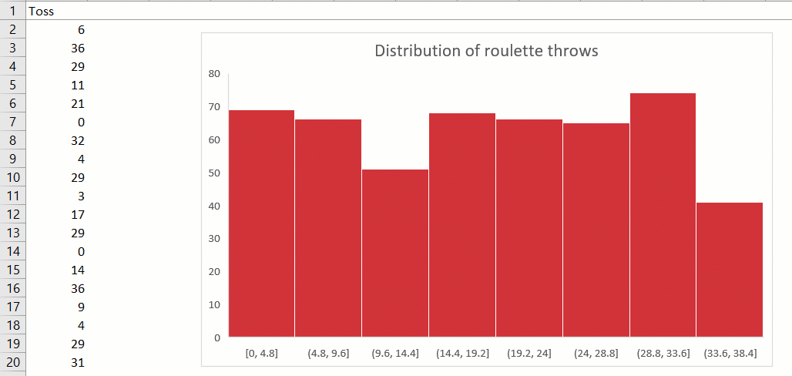
DEMO

Slide 33
DEMO
Now, simulate a roulette toss 100 times.
Take the average toss.
Do this 500 times.
What is the distribution of sample means?

Slide 34
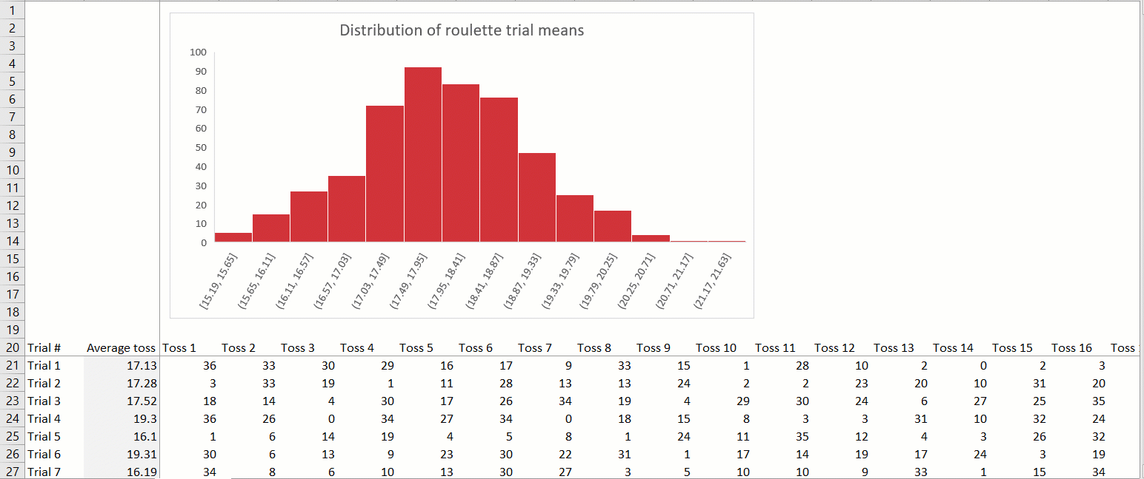
DEMO
Notes:
This is a hidden worksheet in stat-roulette.xlsx

Slide 35

MAGIC… OR STATISTICS?
Central limit theorem: the sampling distribution of the mean of any independent, random variable will be normal or nearly normal, if the sample size is large enough.
Notes:
Instructions follow on the next slide.

Slide 36
How “large enough” is large enough?
N = 30? 60? 100?
It depends on how “normal” your sample is

Slide 37
QUESTIONS?

Slide 38
2. FOUNDATIONS OF INFERENTIAL STATISTICS

Slide 39
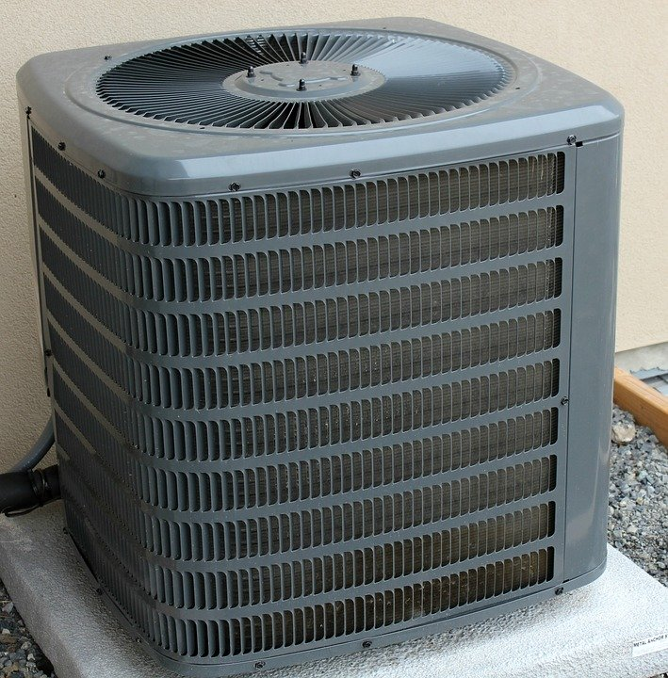
HOUSES WITH AIR CONDITIONING ARE BETTER THAN THOSE WITHOUT

Slide 40
HOUSES WITH AIR CONDITIONING ARE BETTER HAVE HIGHER VALUES THAN THOSE WITHOUT

Slide 41
HOUSES WITH AIR CONDITIONING ARE BETTER HAVE HIGHER VALUES THAN THOSE WITHOUT, ON AVERAGE

Slide 42

THE AVERAGE VALUE OF ONE CATEGORY IS HIGHER THAN ANOTHER
(Independent samples t-test)

Slide 43

DEMO
File: housing.xlsx
Is there a difference in sales price for homes with air conditioning (airco)?

Slide 44

DRILL
File: housing.xlsx
Is there a difference in sales price for homes with a full, finished basement (fullbase)?
Save your work – you’ll “build on” it later!
Notes:
Photo source: https://unsplash.com/photos/T-br3SYp9kw
“Build on” is a pun :P

Slide 45

We have the data… just not all of the data
There is a difference across 546 homes…
… but what about all homes?
Is our sample reflective of their populations?
Notes:
https://unsplash.com/photos/iuqxv7kFj64

Slide 46

… but that doesn’t stop your phlebotomist!
Or your pollster
Or your QA manager
Or your real estate analyst 😉
Notes:
https://pixabay.com/photos/laboratory-analysis-diagnostics-2815639/

Slide 47

GETTING RIGOROUS WITH A HYPOTHESIS
Testable
Falsifiable
Burden of proof on the claimant

Slide 48
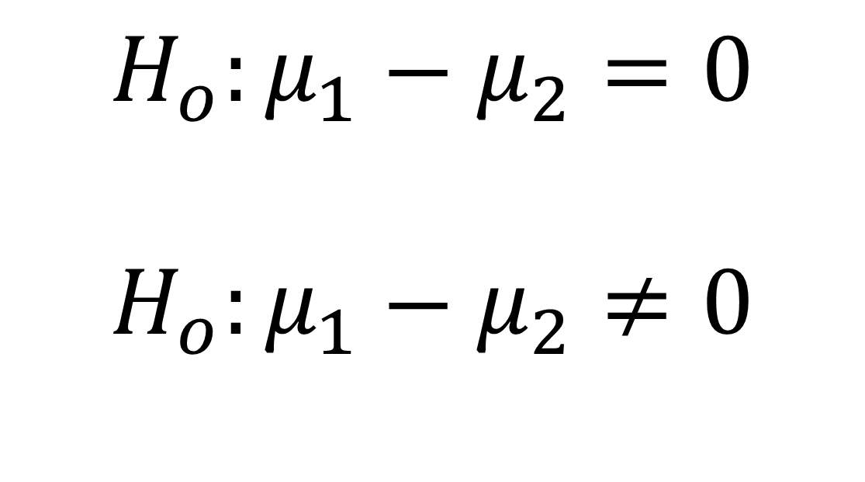
GETTING RIGOROUS WITH A HYPOTHESIS
Null: no difference in population means
$$H_{o}:μ_{1}−μ_{2}=0$$
$$H_{o}:μ_{1}−μ_{2}≠0$$
Alternative: some difference in population means

Slide 49
… but we don’t know the population means…
Central limit theorem to the rescue!
Infer the population mean (which is normally distributed) given a sample mean…
... Some uncertainty required.
Usually 5%
Notes:
https://pixabay.com/photos/laboratory-analysis-diagnostics-2815639/

Slide 50
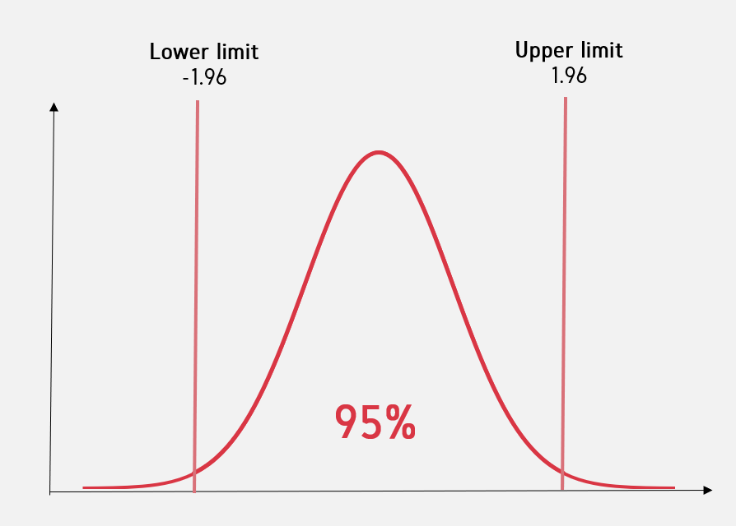
Critical value

Slide 51
EXPLICIT WARNING:
MATH AHEAD

Slide 52
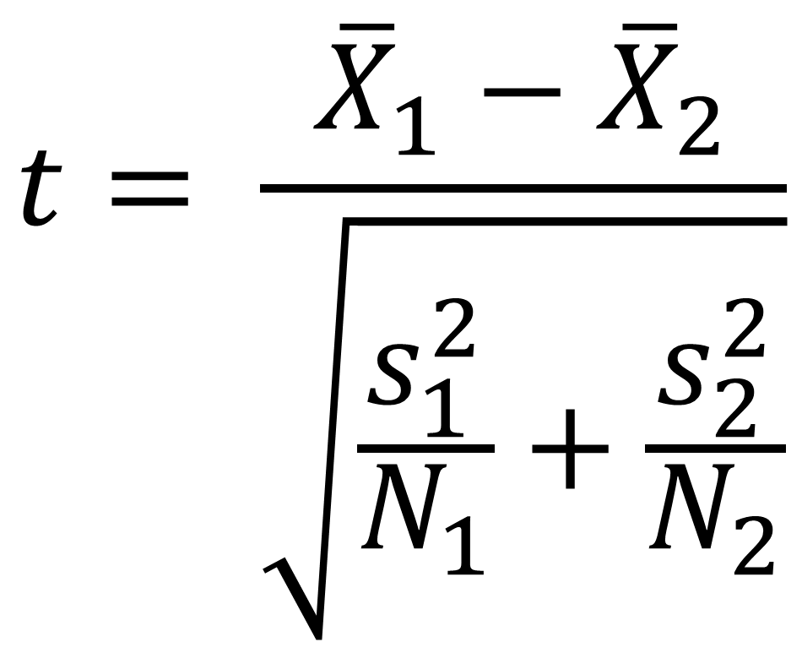
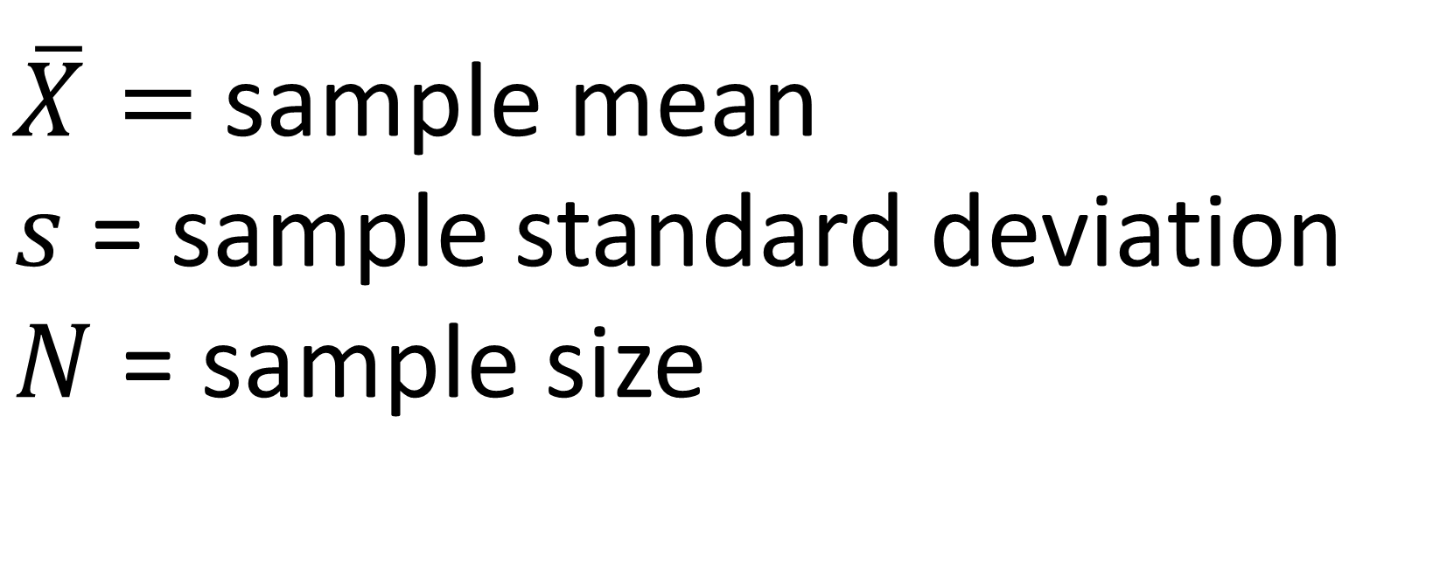
Calculating the test statistic
$$t= \frac{{\overline{X}}_{1}−{\overline{X}}_{2}}{\sqrt{\frac{s_{1}^{2}}{N_{1}}+\frac{s_{2}^{2}}{N_{2}}}}$$
$\overline{X}=$ sample mean
$s$ = sample standard deviation
$N$ = sample size

Slide 53
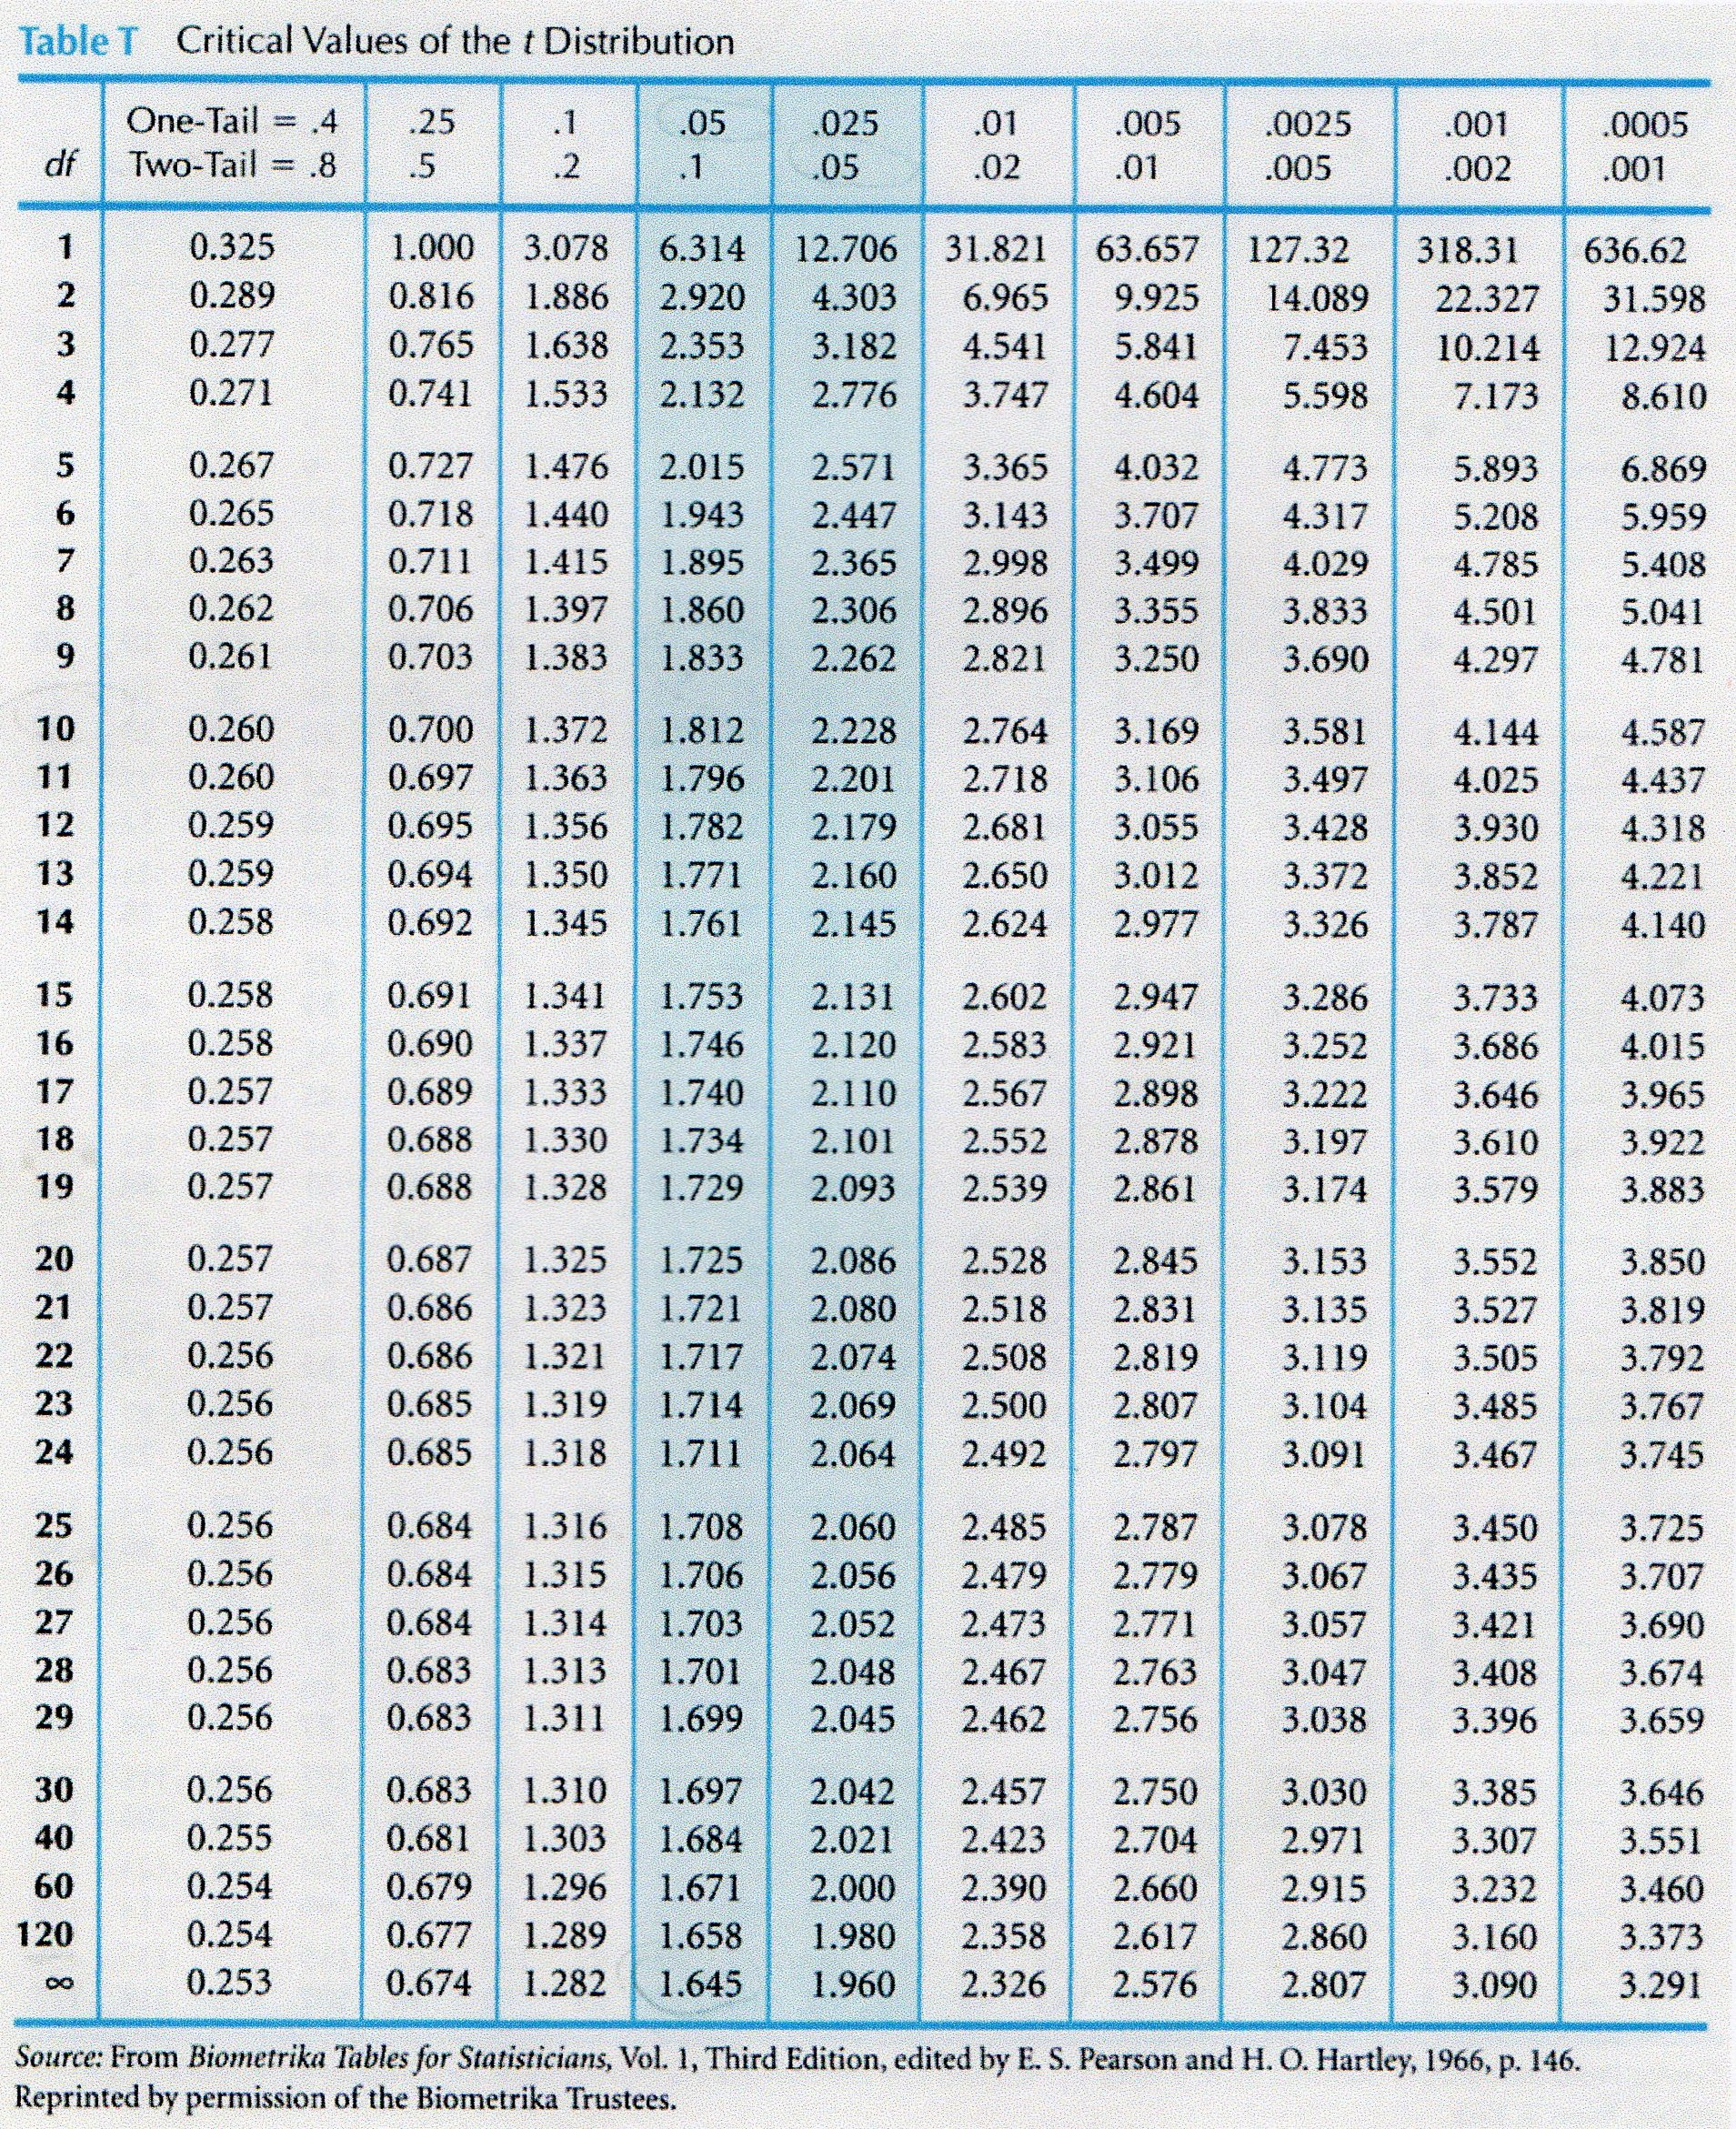
For every test statistic, a p-value
Notes:
We will get more into depth about how to interpret this p-value later.
A confidence interval is a range of population values with which the sample data are compatible. A significance test considers the likelihood that the sample data has come from a particular hypothesised population.

Slide 54
Does the test score exceed the critical value?
Yes: Reject the null

Slide 55
Does the test score exceed the critical value?
Yes: Reject the null. There is likely to be a significant difference in means.
No: Fail to reject the null. There is unlikely to be a significant difference in means.

Slide 56

In statistics, nothing is proven, everything is falsifiable.

Slide 57
QUESTIONS?

Slide 58
3. T-TESTS FOR BUSINESS IMPACT

Slide 59
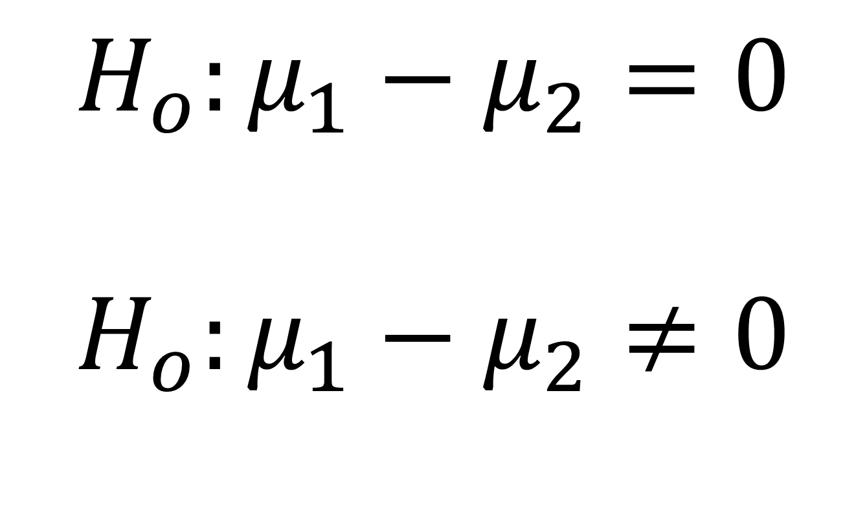
WARM-UP
We want to test for a significant difference in sale price between houses with and without air conditioning.
What are our hypotheses?
$$H_{o}:μ_{1}−μ_{2}=0$$
$$H_{o}:μ_{1}−μ_{2}≠0$$

Slide 60
DEMO
File: housing-inferential.xlsx
Is there a significant difference in sales price for homes with air conditioning?

Slide 61
DRILL
File: housing-inferential.xlsx
Is there a significant difference in sales price for homes with a full, finished basement?

Slide 62
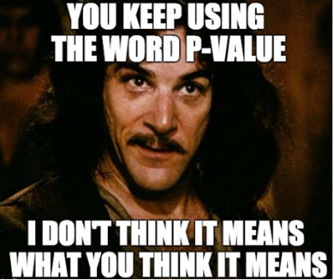
A p-value is NOT a probability of making a mistake.
A p-value is the probability of obtaining an effect at least as extreme as the one in your sample data, assuming the null hypothesis is true.

Slide 63
INTERPRETING P-VALUES
p-value | Interpretation
.02 | Assuming the null is true, you would obtain the observed difference or more in 2% of samples due to random error.
.085 | Assuming the null is true, you would obtain the observed difference or more in 8.5% of samples due to random error.
.5 | Assuming the null is true, you would obtain the observed difference or more in 50% of samples due to random error.
.005 | Assuming the null is true, you would obtain the observed difference or more in .05% of samples due to random error.

Slide 64
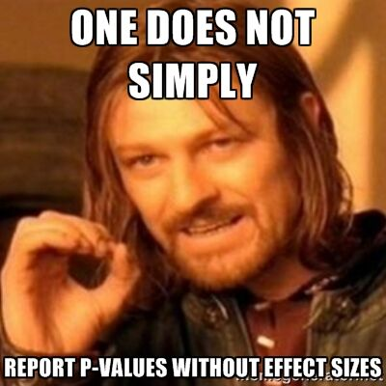
A p-value is NOT a substantive measure.
A p-value does not tell you how much of a difference there is, only that there is likely to be a difference.
The confidence interval will give us a substantive measure.

Slide 65
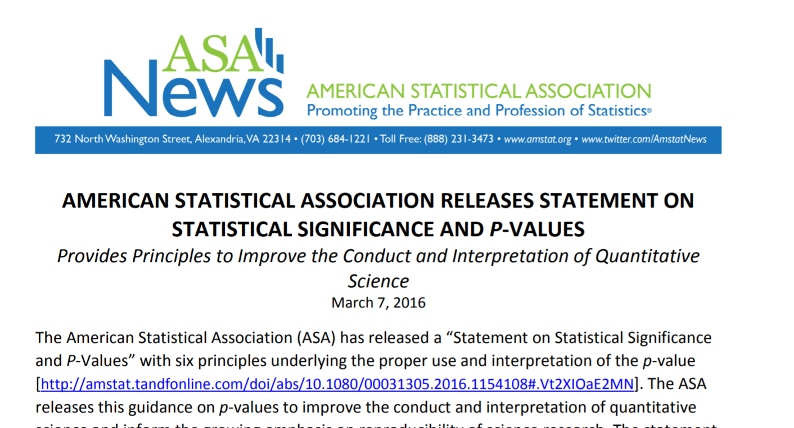
ONE STAT TO RULE THEM ALL
https://www.amstat.org/asa/files/pdfs/P-ValueStatement.pdf

Slide 66
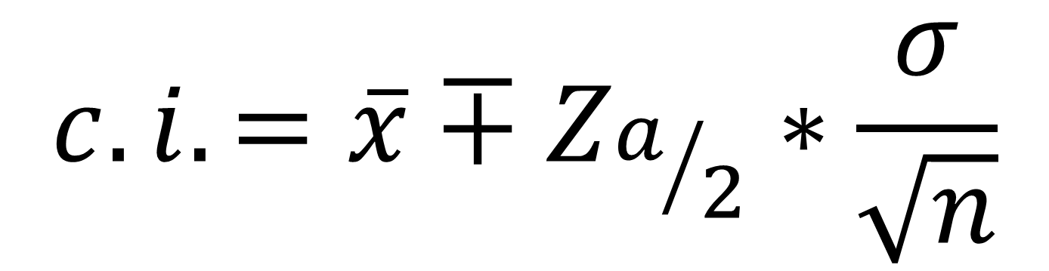
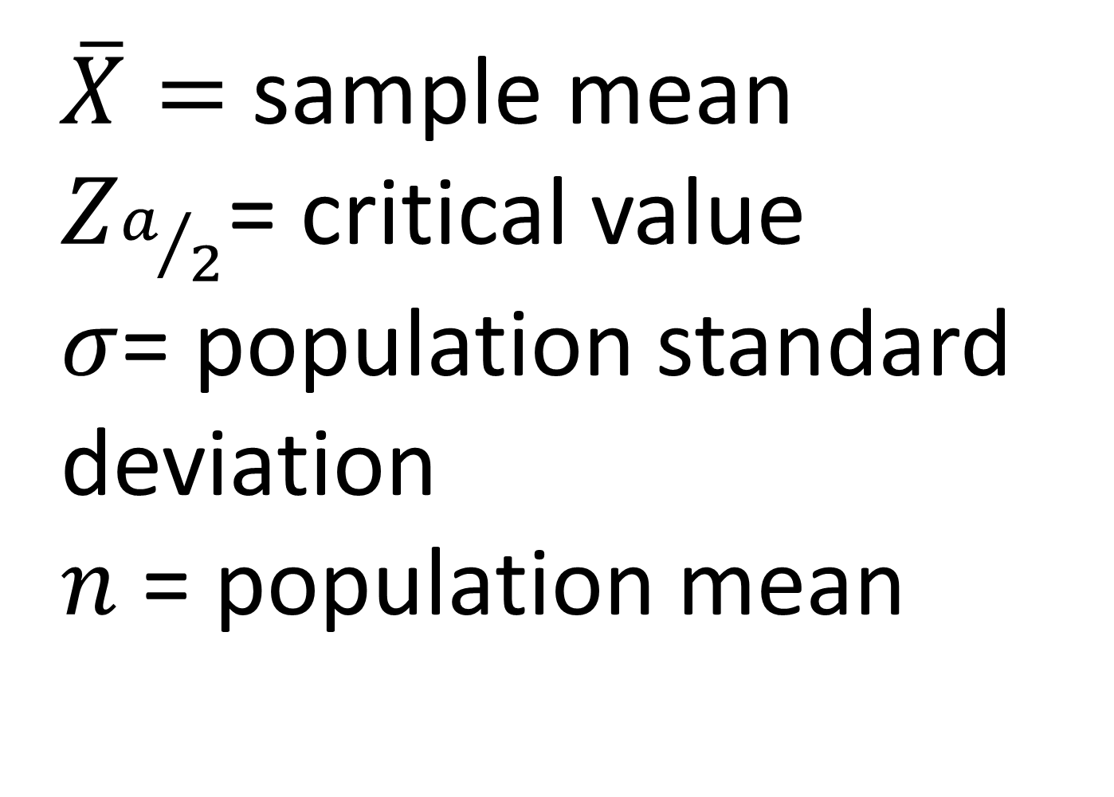
Calculating the confidence interval
$$c.i.=\overline{x}∓Z_{a/2}∗\frac{σ}{\sqrt{n}}$$
$\overline{X}=$ sample mean
$Z_{a/2}$= critical value
$σ$= population standard deviation
$n$ = population mean
1. Point estimate
2. Standard error
3. Margin of error

Slide 67
DEMO
File: housing-inferential.xlsx (continued)
Calculate the confidence interval for difference in prices for homes with air conditioning

Slide 68
DRILL
File: housing-inferential.xlsx (continued)
Calculate the confidence interval for difference in prices for homes with a full, finished basement

Slide 69

PRESENTING T-TEST RESULTS FOR BUSINESS IMPACT
Methods are not stories
Translate to the universal denominator … $
When in doubt, visualize it

Slide 70
DEMO
File: housing-inferential.xlsx (continued)
Visualize the difference in average sales price for homes with air conditioning

Slide 71
DRILL
File: housing-inferential.xlsx (continued)
Visualize the difference in average sales price for homes with gas for hot water heating (gashw)

Slide 72
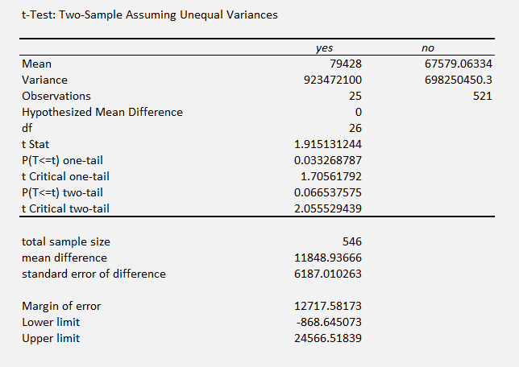
It’s your world, the statistics are just living in it
A p-value has wiggle room
A confidence interval communicates what’s at stake
A larger sample size can lead to more robust results
CASE
WHEN condition THEN result-expression
WHEN condition THEN result-expression ...
ELSE result-expression
END AS alias

Slide 73
QUESTIONS?

Slide 74
4. CONCLUSION

Slide 75
Future learning
Check the datasets folder for additional t-test practice
A/B testing & experimental design
Testing multiple categories/non-normal categories
Linear regression

Slide 76
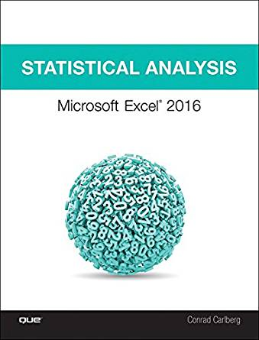
Statistical Analysis: Microsoft Excel 2016, by Conrad Carlberg
On O’Reilly Learning at https://learning.oreilly.com/library/view/statistical-analysis-microsoft/9780134840437/
Human Centered Design • MDLS 2020

Slide 77

Data Smart: Using Data Science to Transform Information into Insight,
by John Foreman
On O’Reilly Learning at https://learning.oreilly.com/library/view/data-smart-using/9781118661468/
Human Centered Design • MDLS 2020

Slide 78
LET'S TALK
LINKEDIN
linkedin.com/in/gjmount
EMAIL ADDRESS
george@stringfestanalytics.com
WEBSITE
stringfestanalytics.com
GITHUB
github.com/summerofgeorge

